Slide 1
We can read sight words.

Slide 2
red

Slide 3
green

Slide 4
yellow

Slide 5
blue

Slide 6
white

Slide 7
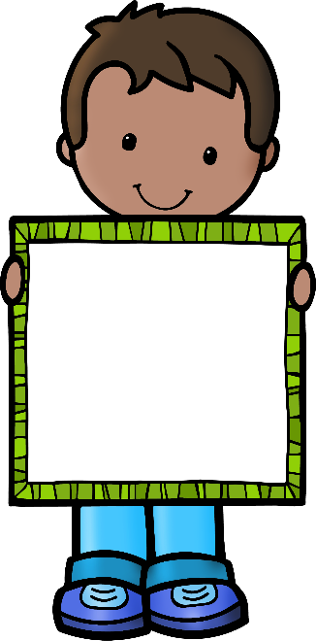
pink

Slide 8
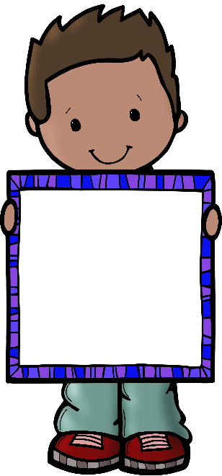
gray

Slide 9
purple

Slide 10
brown

Slide 11
the

Slide 12
of

Slide 13
and

